Slide 1
OCI: FortiGate-VM A-A NLB Sandwich with DRG
Sept 2023

Slide 2
Summary
Base Template: https://github.com/40net-cloud/fortinet-oci-solutions/tree/main/FortiGate/Active-Active/Dual-AD/New-VCN
The Base Template is a Terraform template that deploys the solution for E-W inspection. Additional configuration is required to enable N-S and S-W traffic inspection. Details of the configuration is included in this dec
FortiGate-VMs ‘see’ the source IP addresses for N-S, S-N and E-W traffic flow. Ensure Source/Dest IP is enabled on the NLBs
FortiGate-VM will NAT the traffic to ensure traffic is symmetric

Slide 3
Traffic Flow

Slide 4
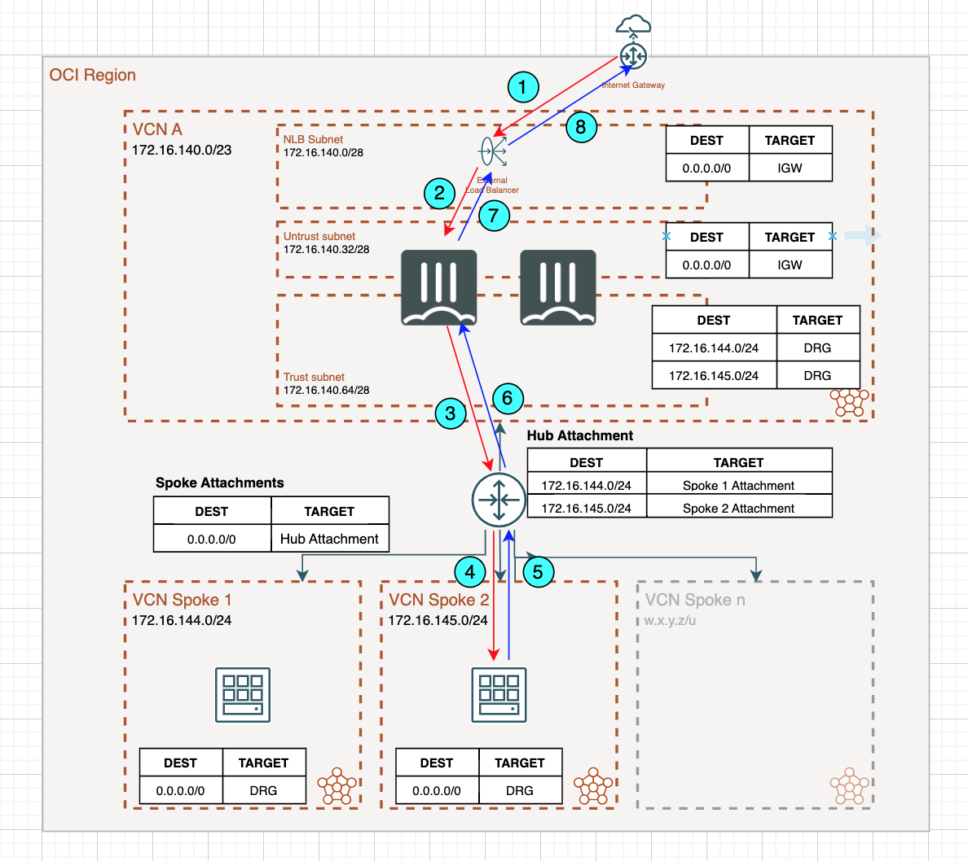
Traffic Flow: North - South

Slide 5
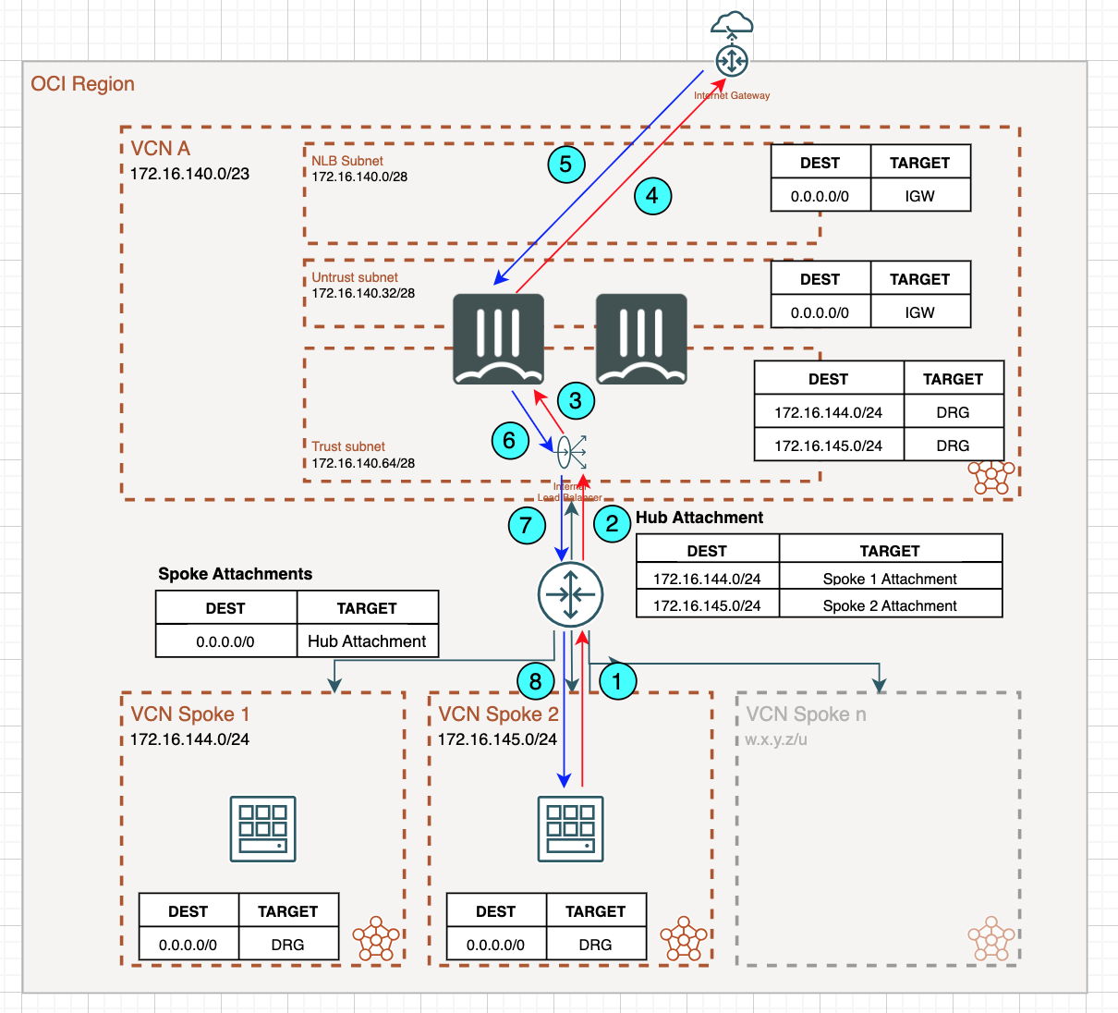
Traffic Flow: South - North

Slide 6
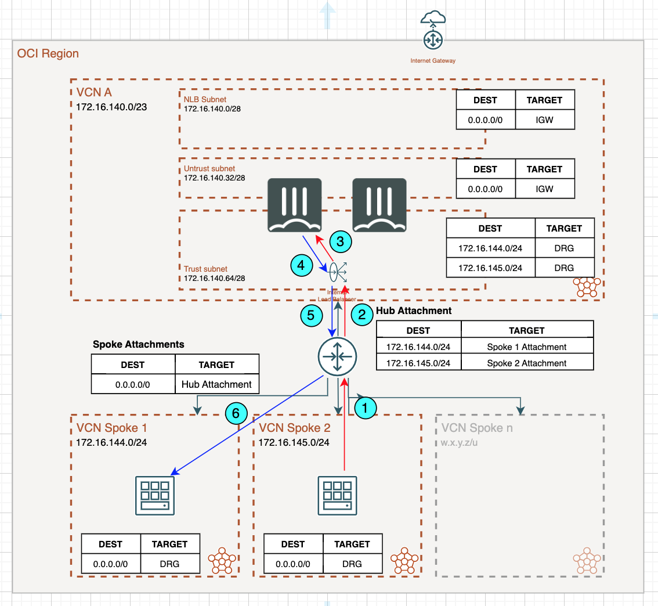
Traffic Flow: East - West

Slide 7
Configuration: Security VCN

Slide 8
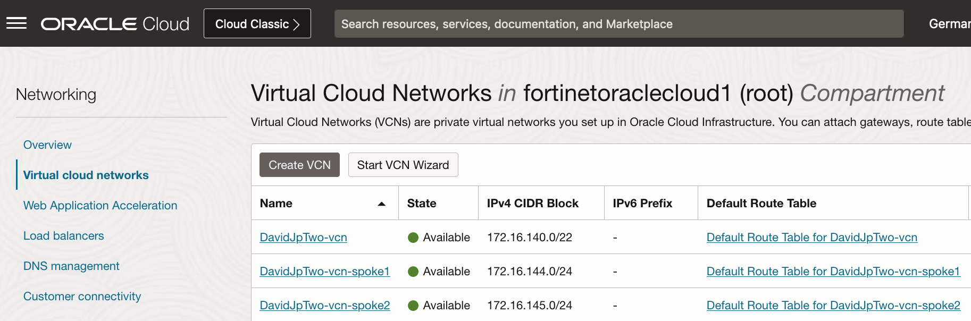
Configuration: VCN

Slide 9
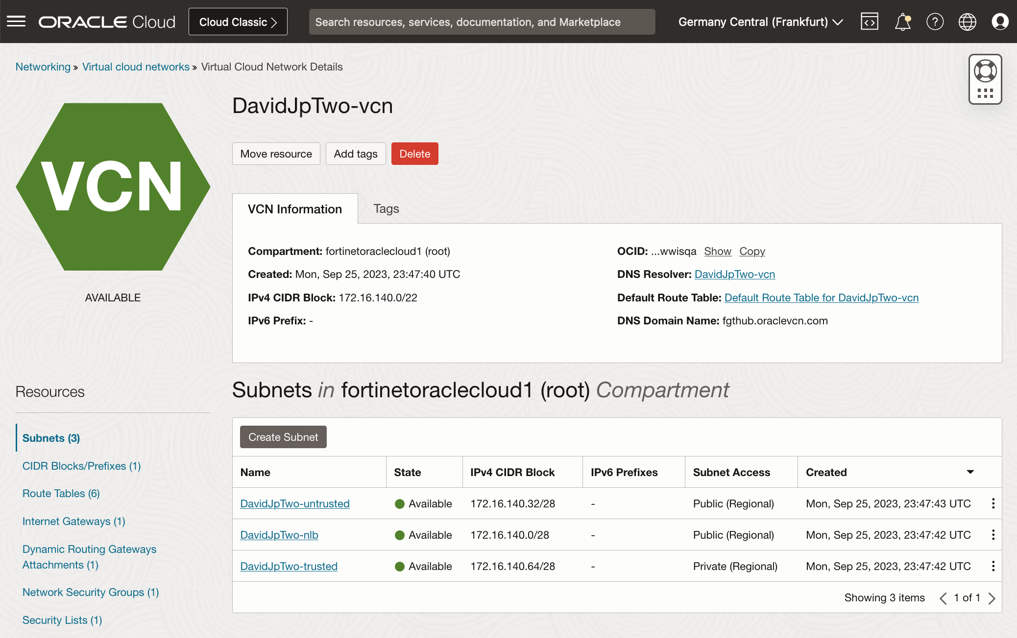
Configuration: Security VCN

Slide 10
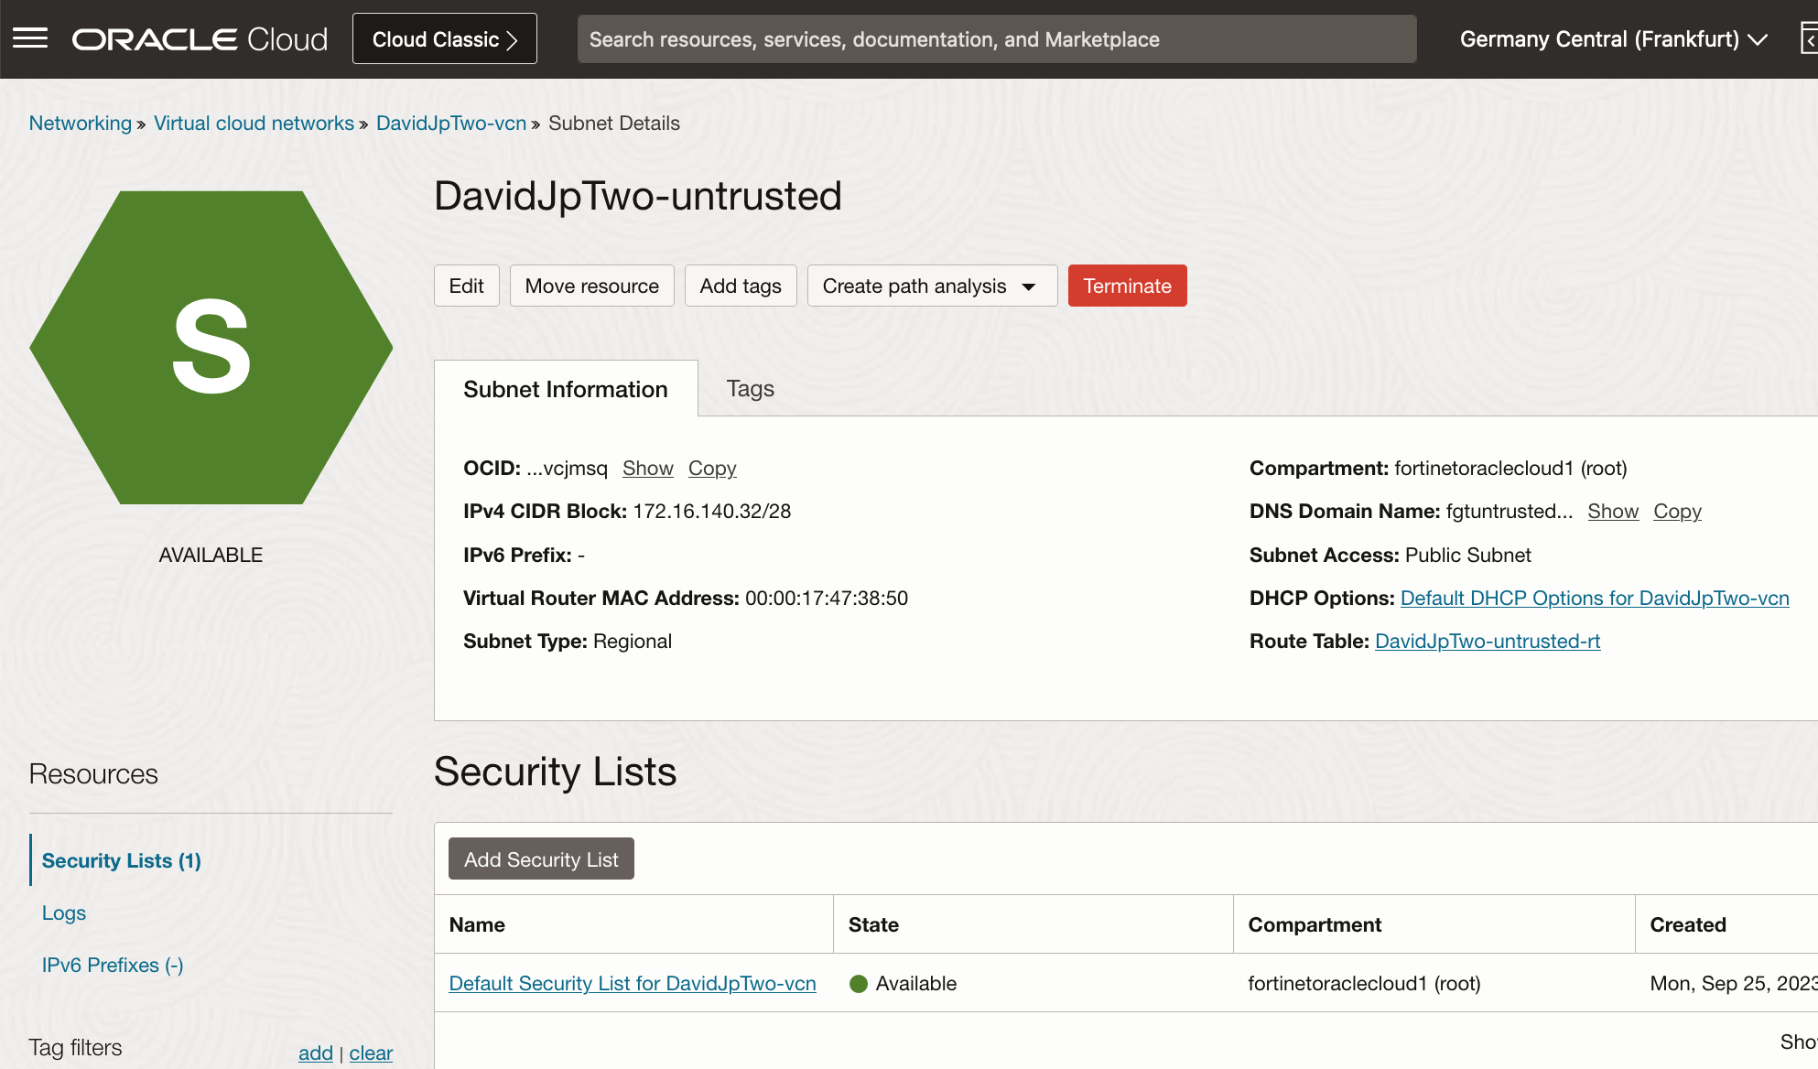
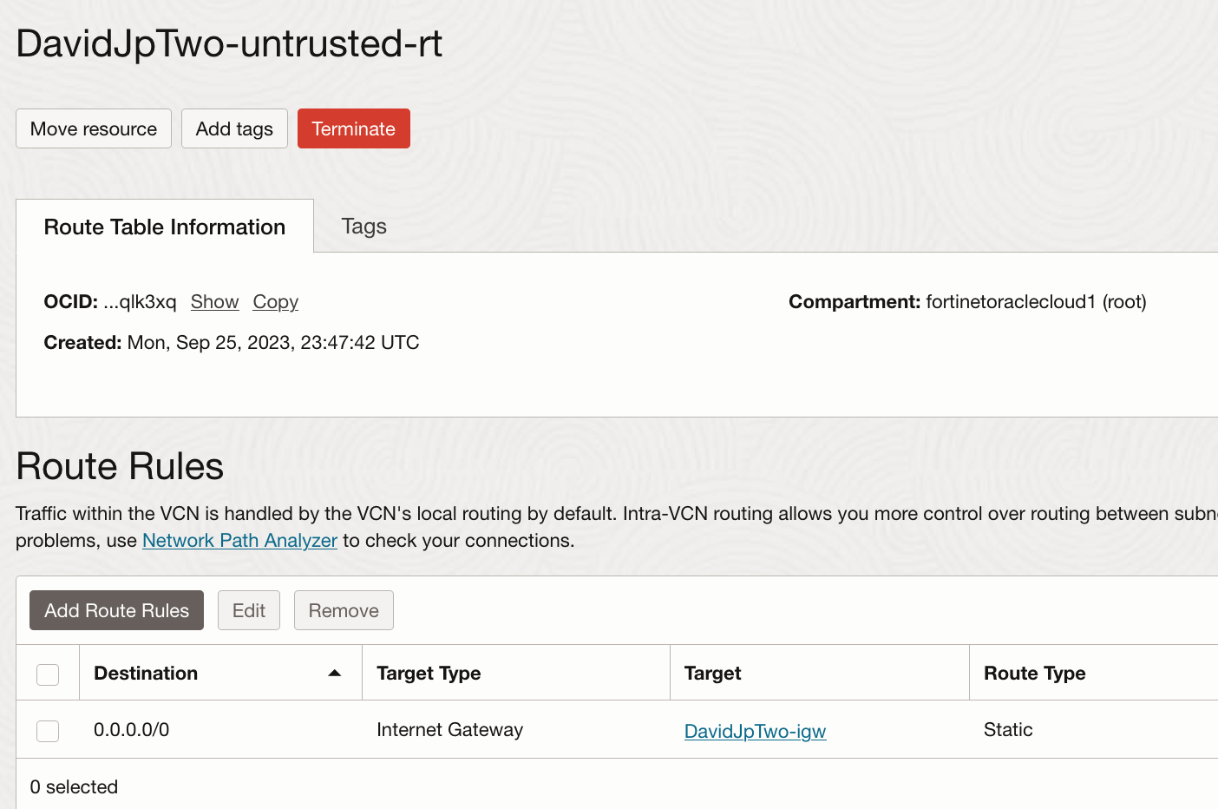
Configuration: Security VCN

Slide 11
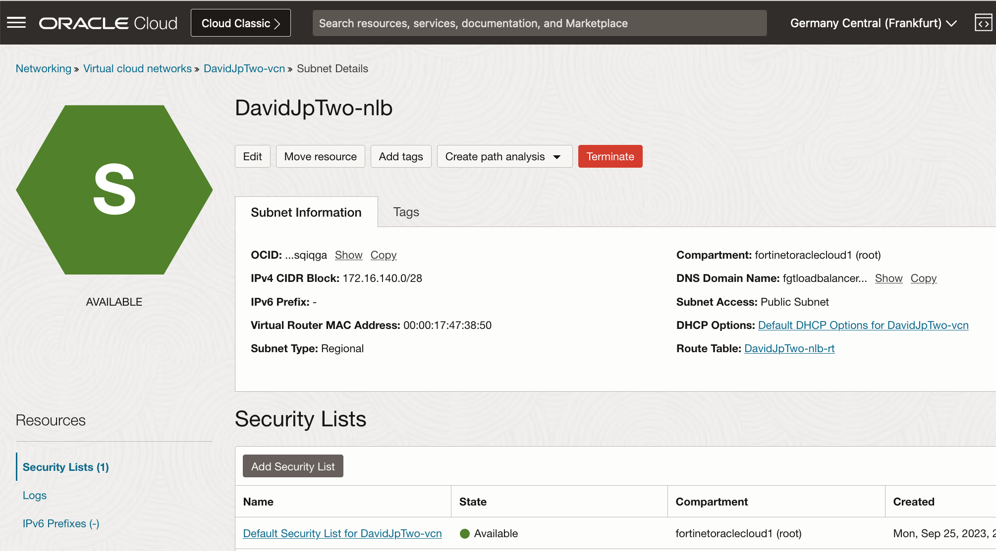
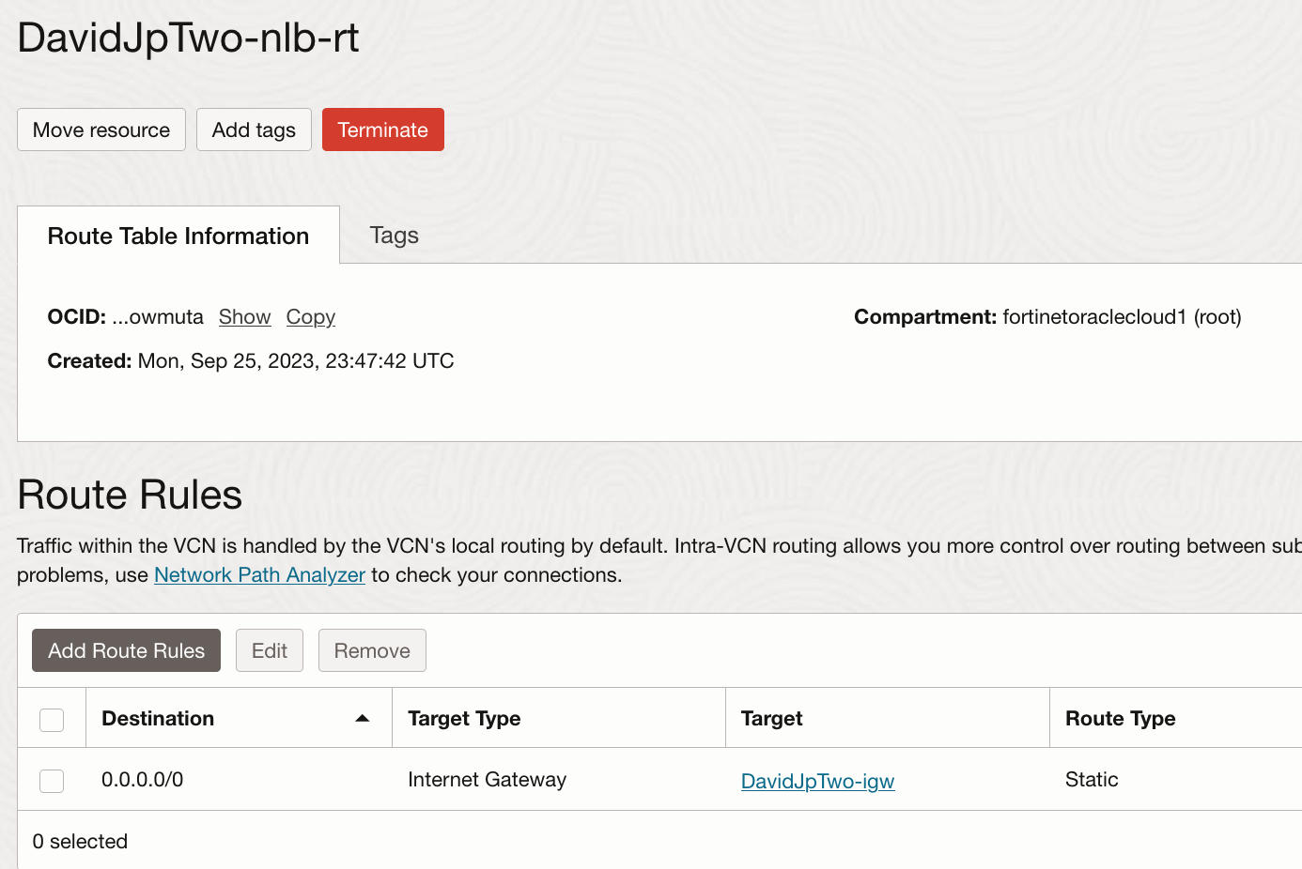
Configuration: Security VCN

Slide 12

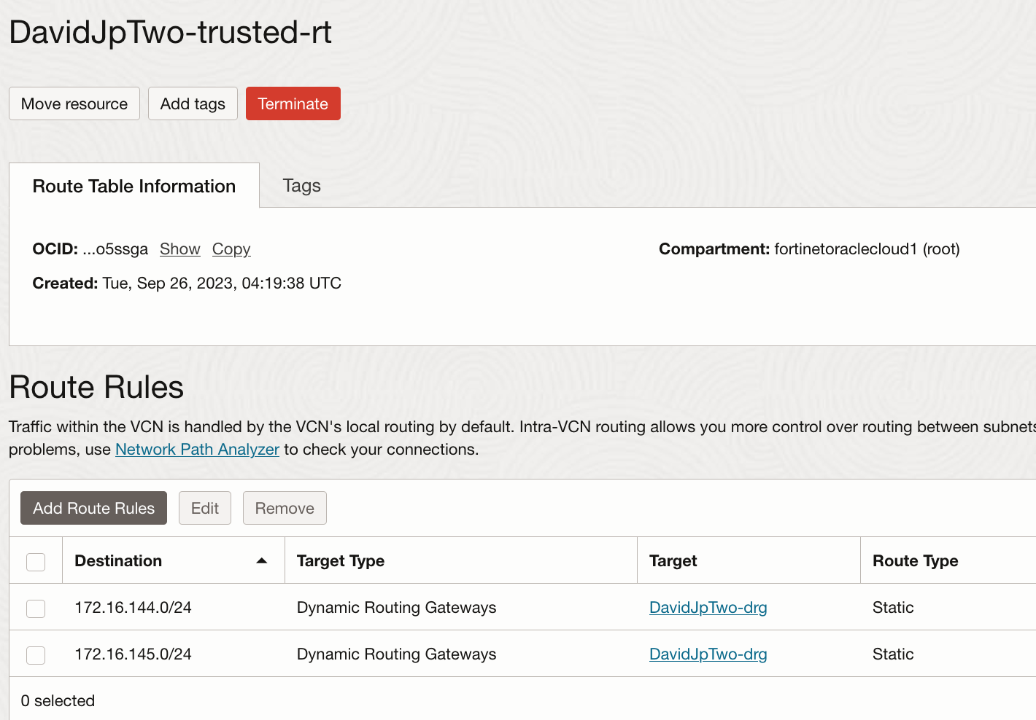
Configuration: Security VCN

Slide 13
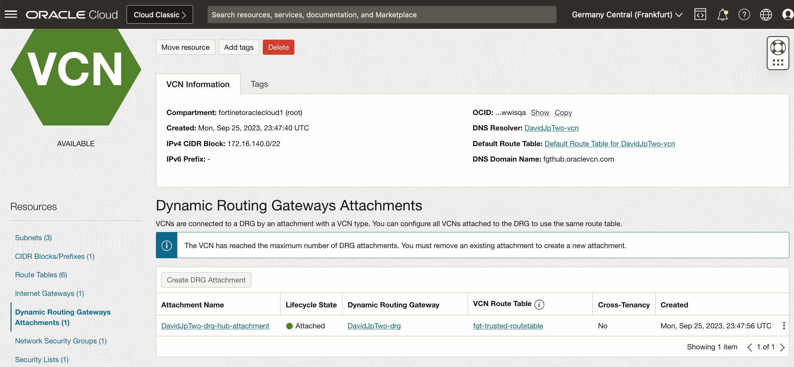
Configuration: Security VCN

Slide 14
Configuration: Spoke1 VCN

Slide 15
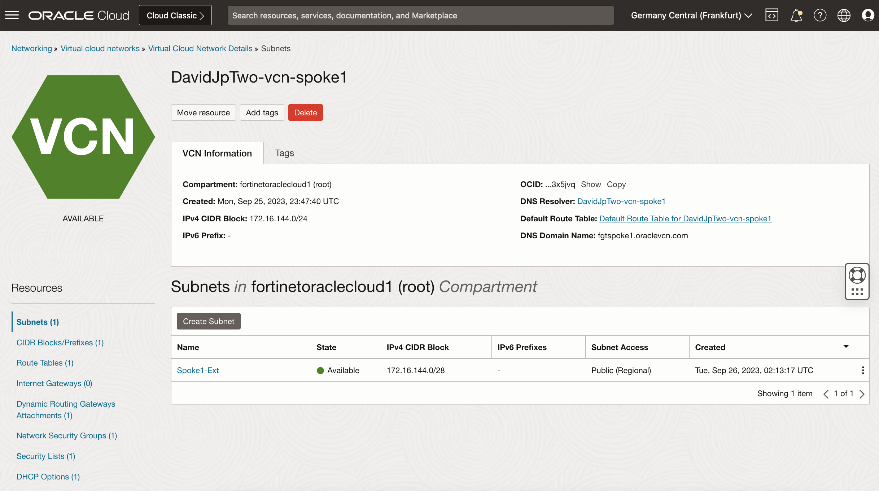
Configuration: Spoke1 VCN

Slide 16
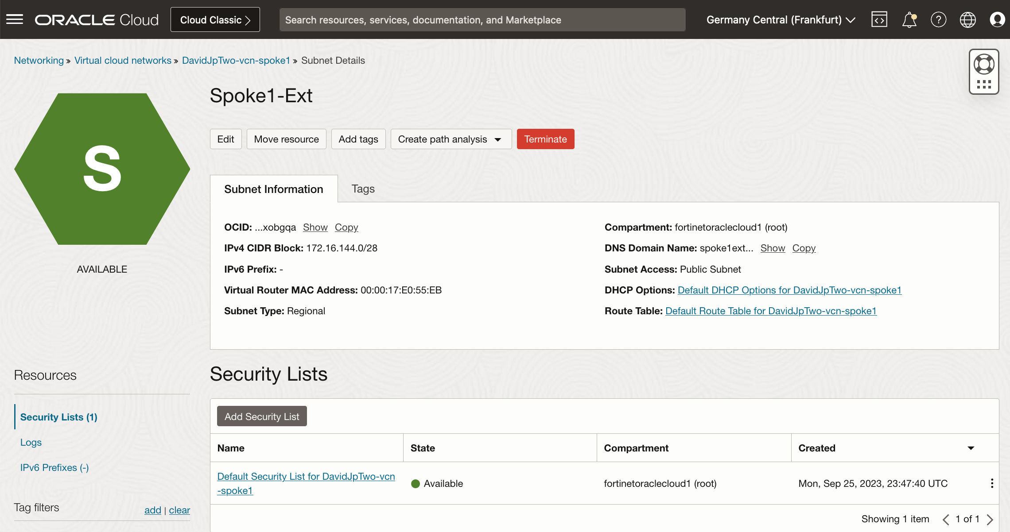
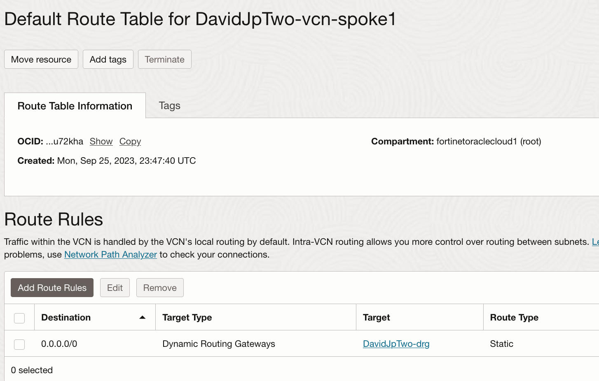
Configuration: Spoke1 VCN

Slide 17
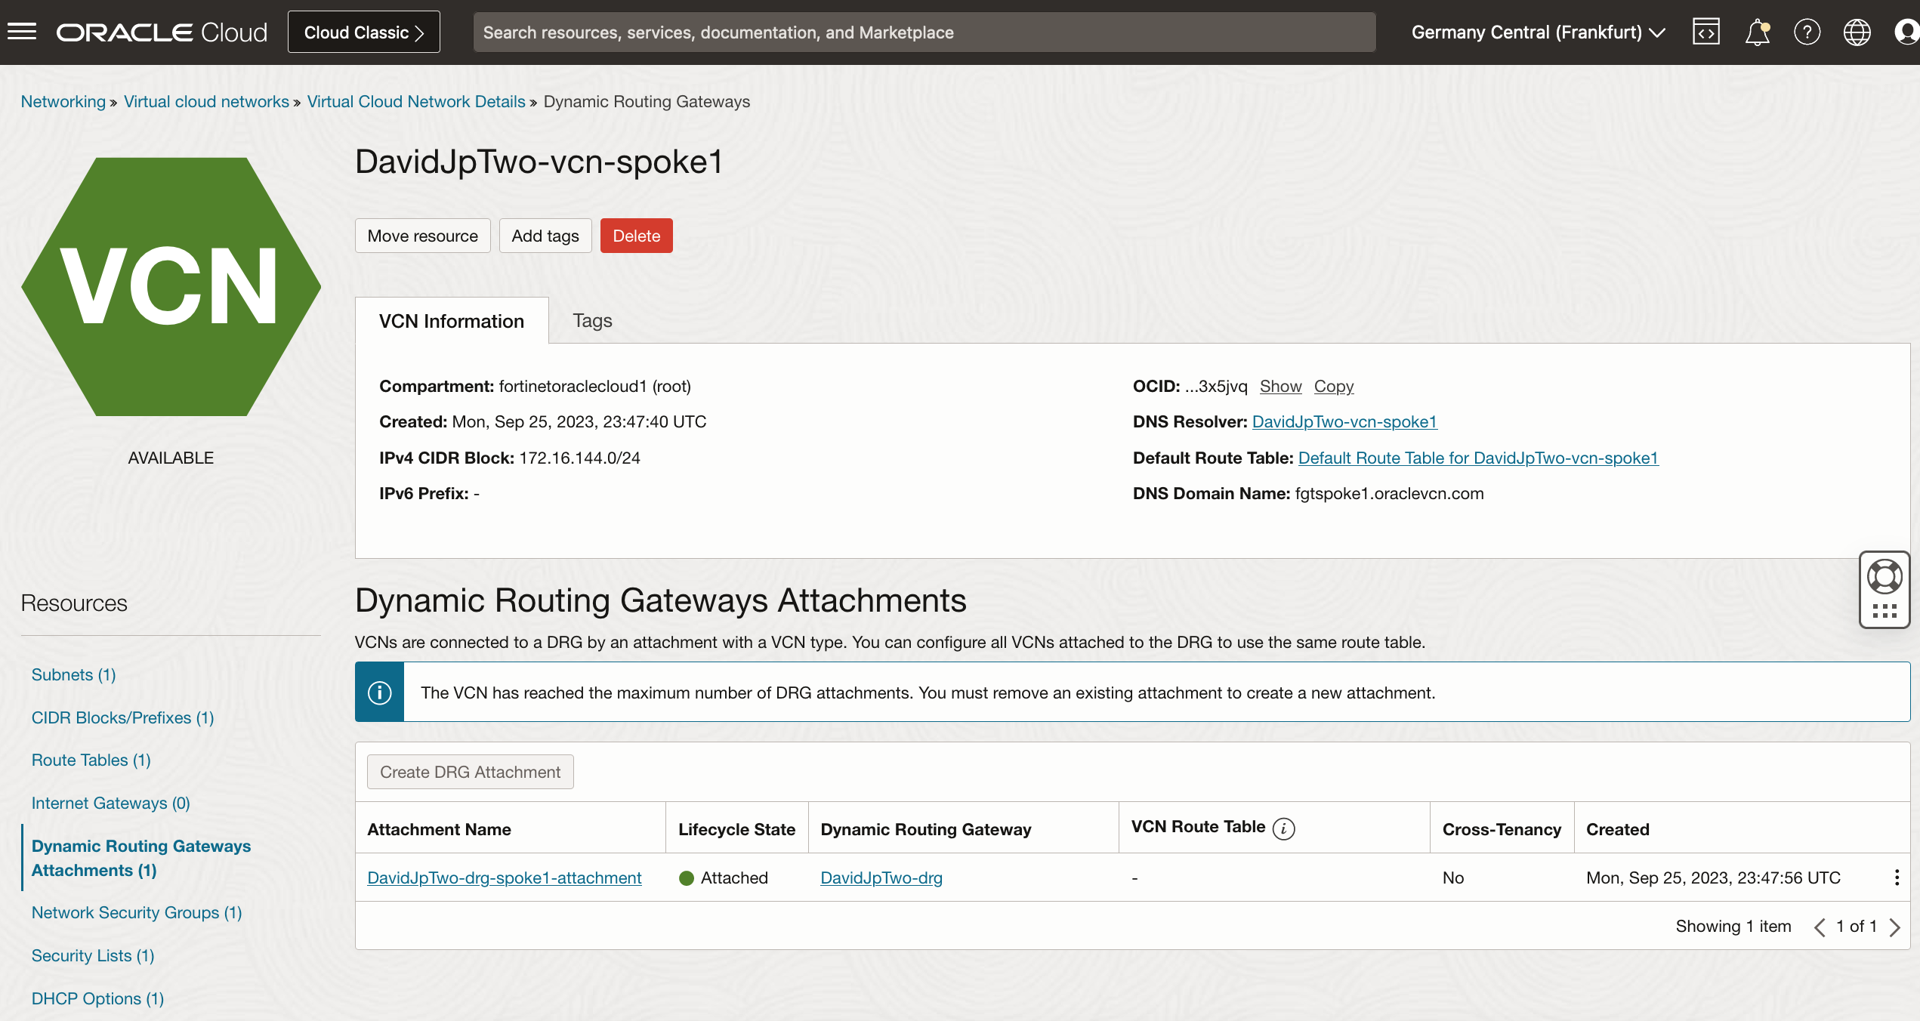
Configuration: Spoke1 VCN

Slide 18
Configuration: Spoke2 VCN

Slide 19
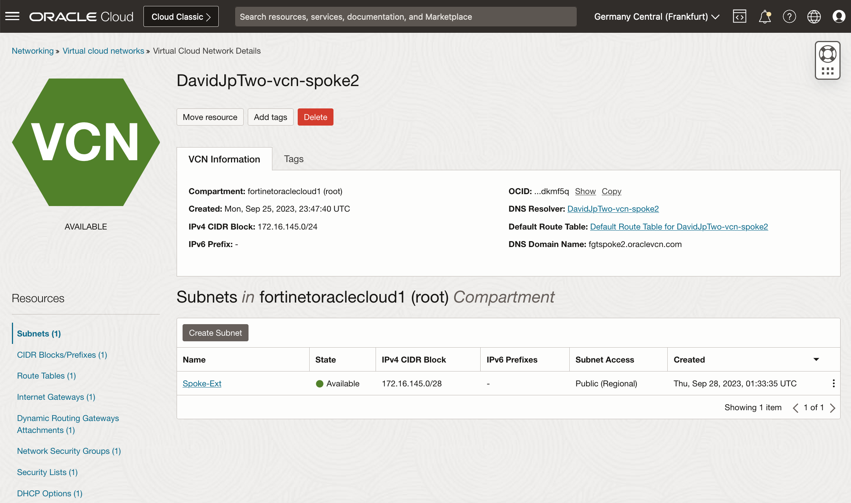
Configuration: Spoke2 VCN

Slide 20
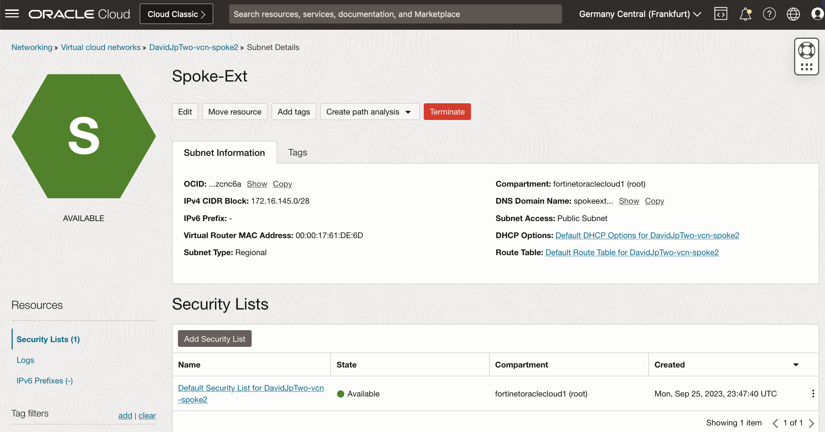
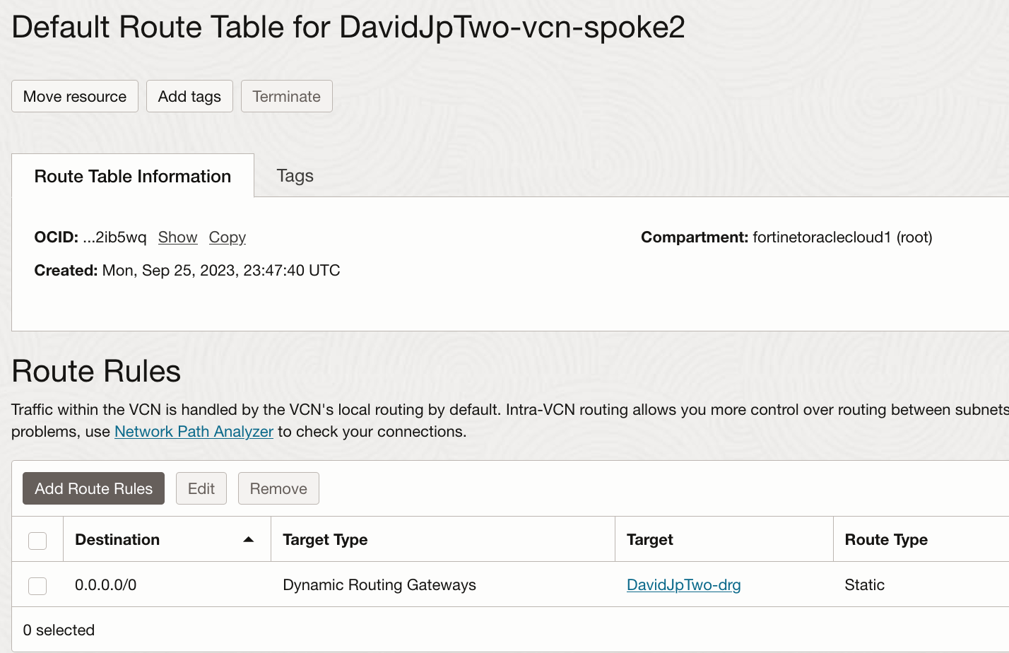
Configuration: Spoke2 VCN

Slide 21
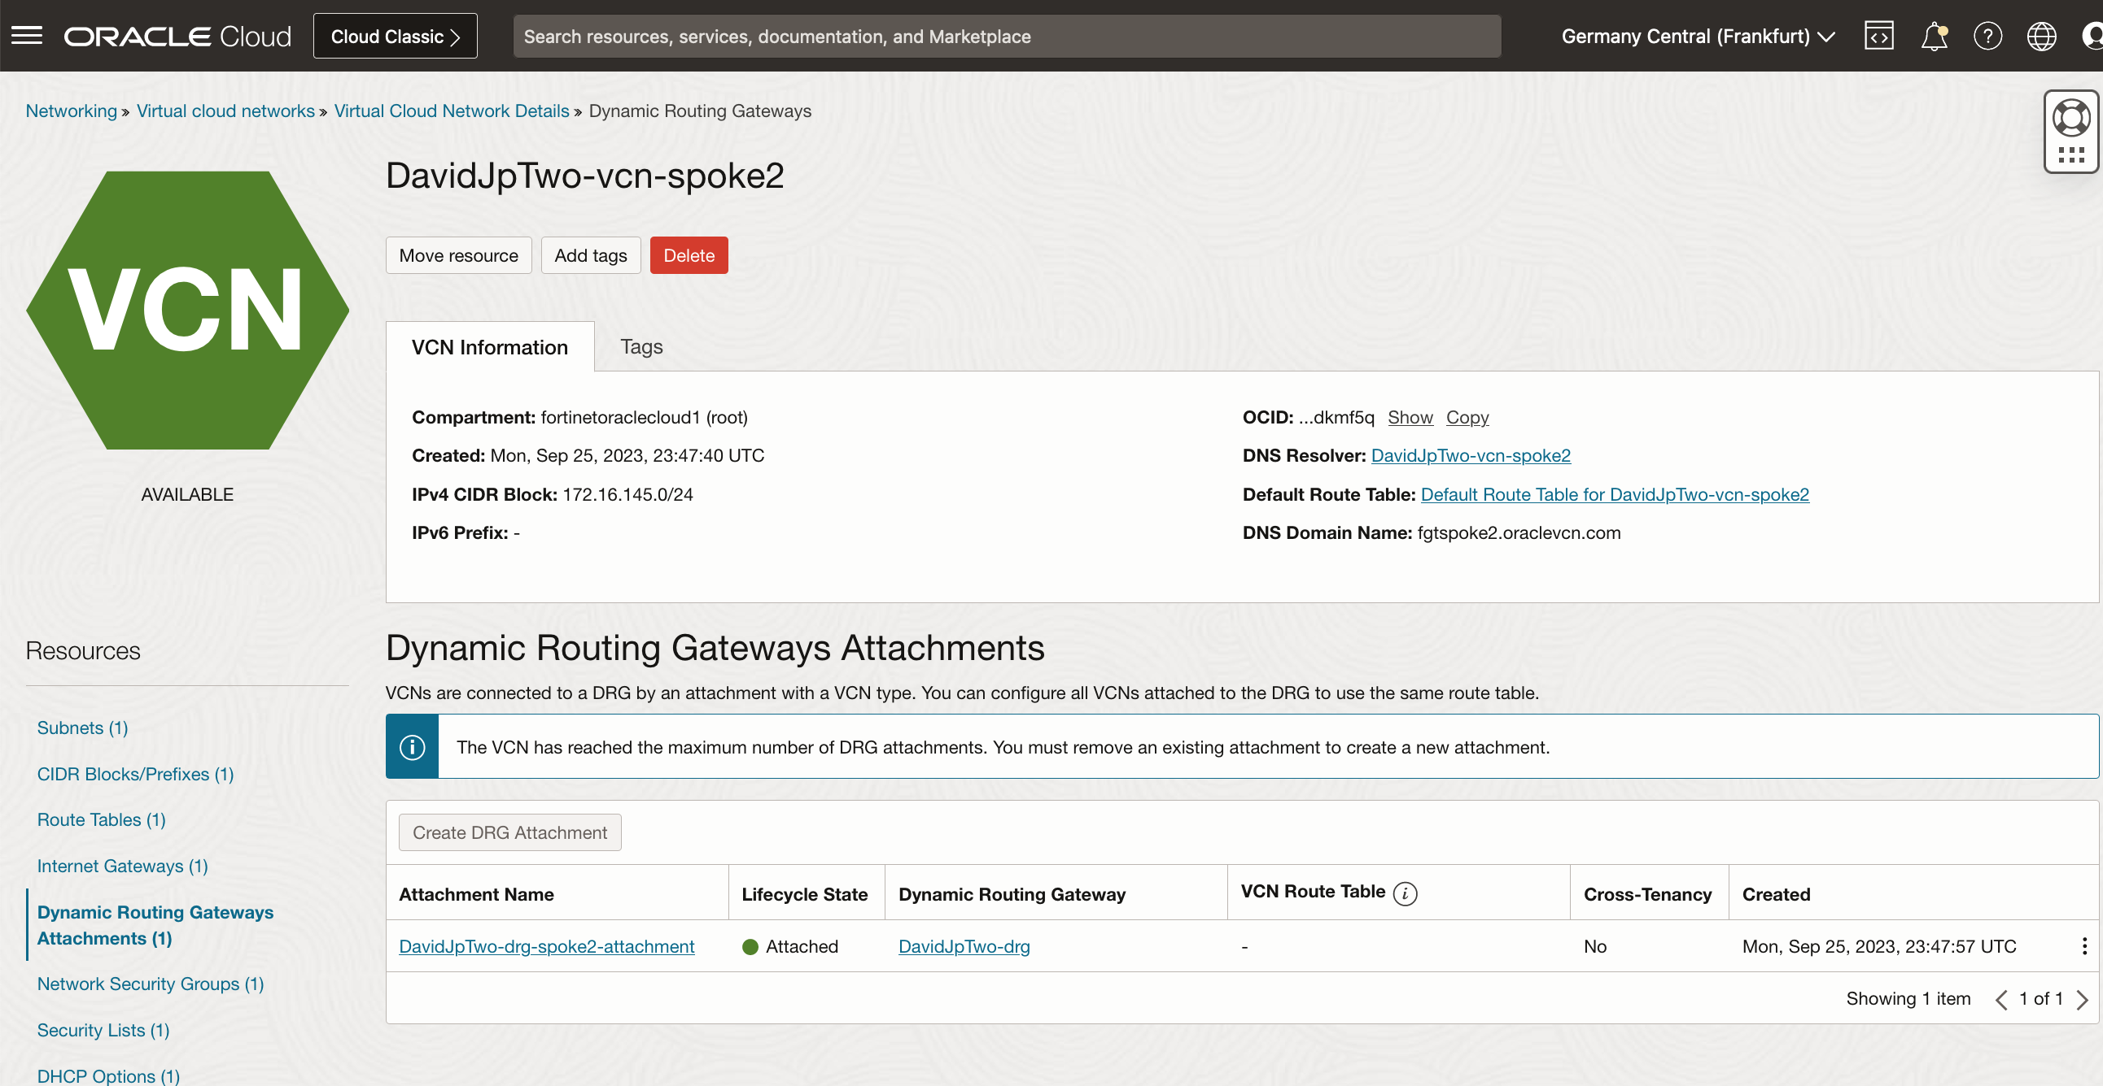
Configuration: Spoke2 VCN

Slide 22
Configuration:DRG

Slide 23
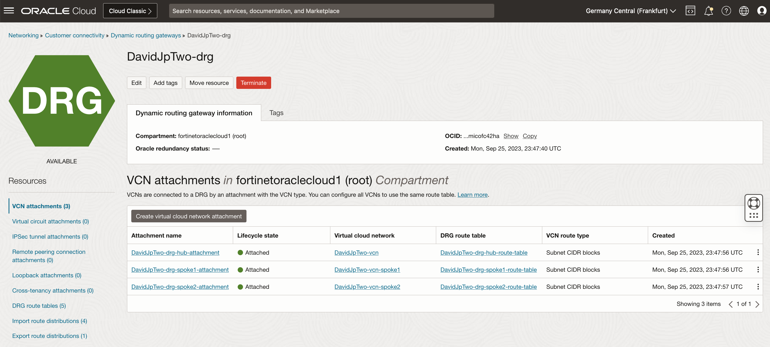
Configuration: DRG

Slide 24
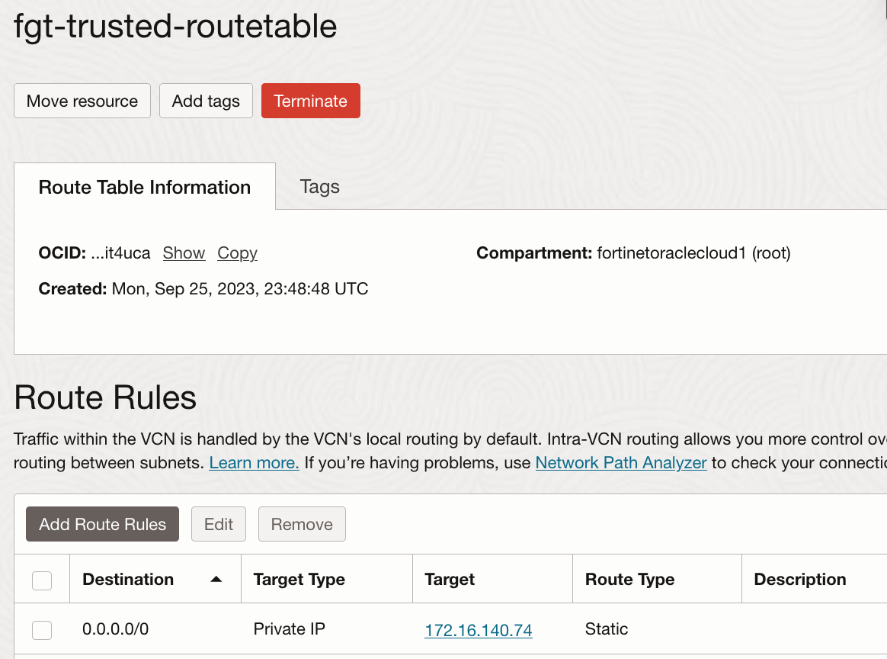
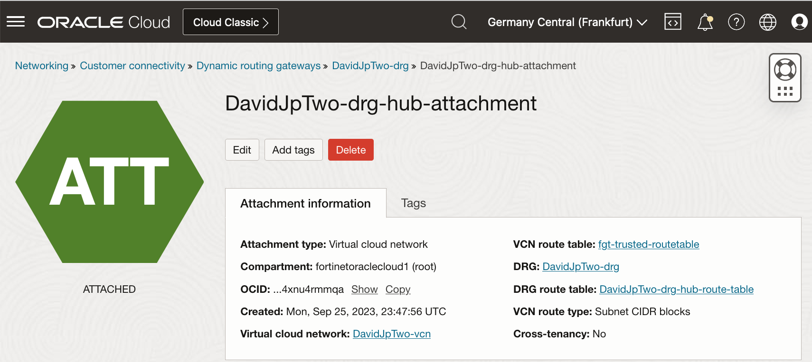
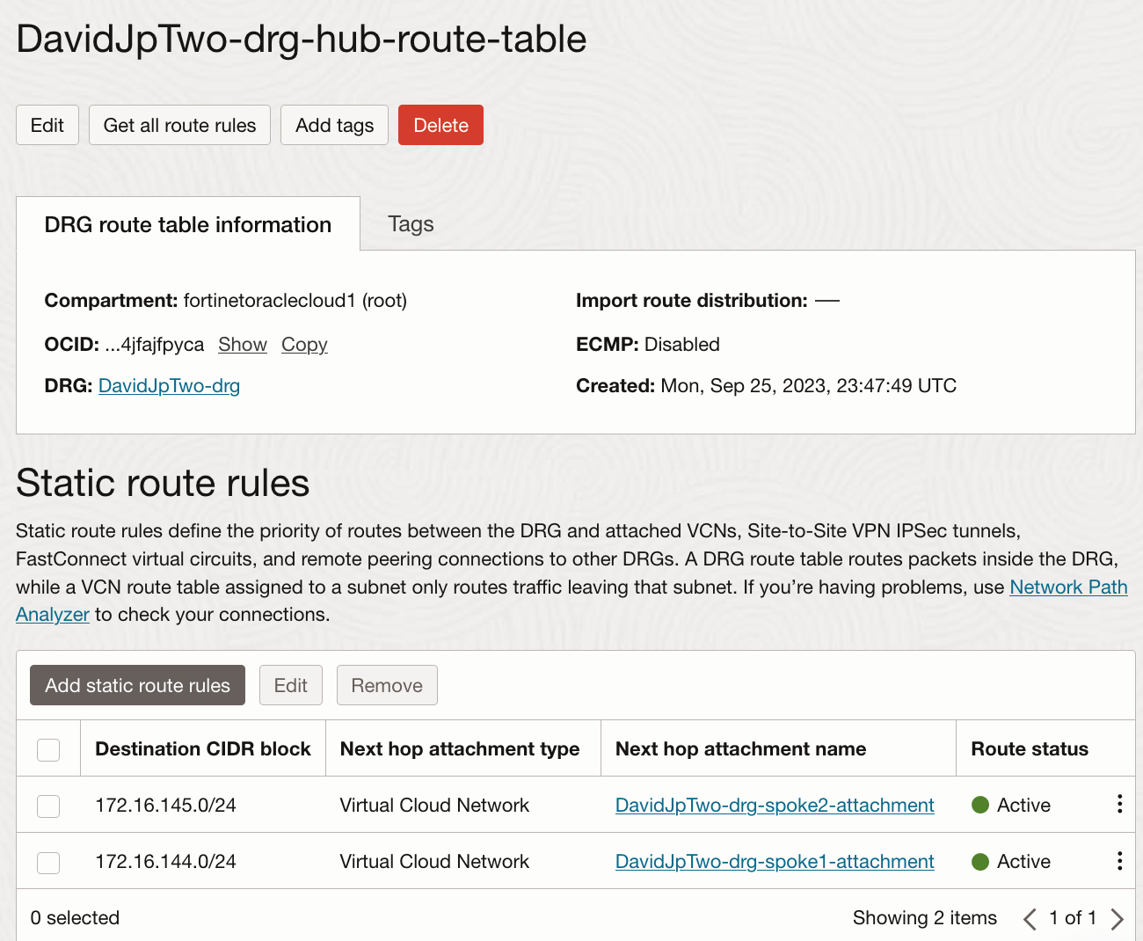
Configuration: DRG

Slide 25
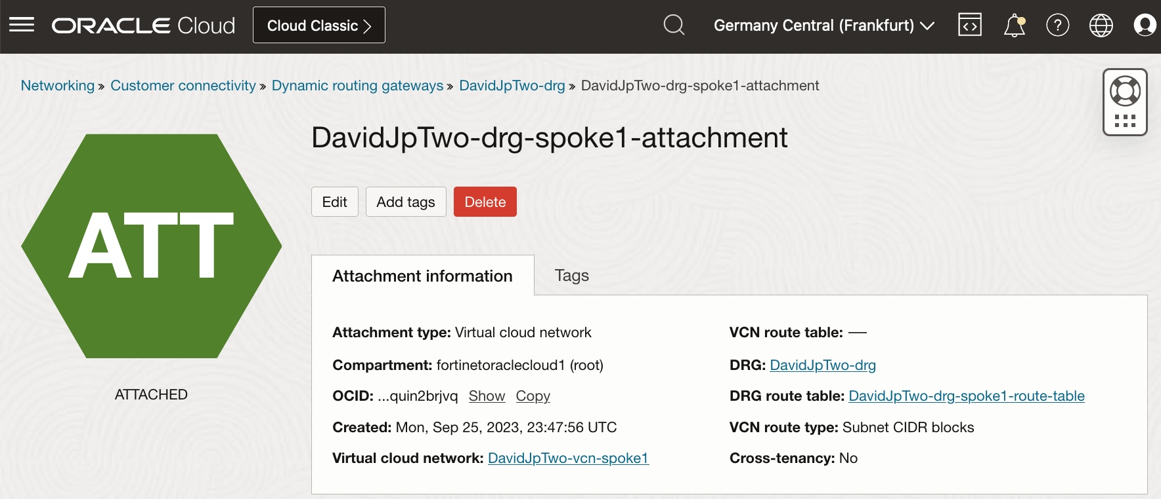
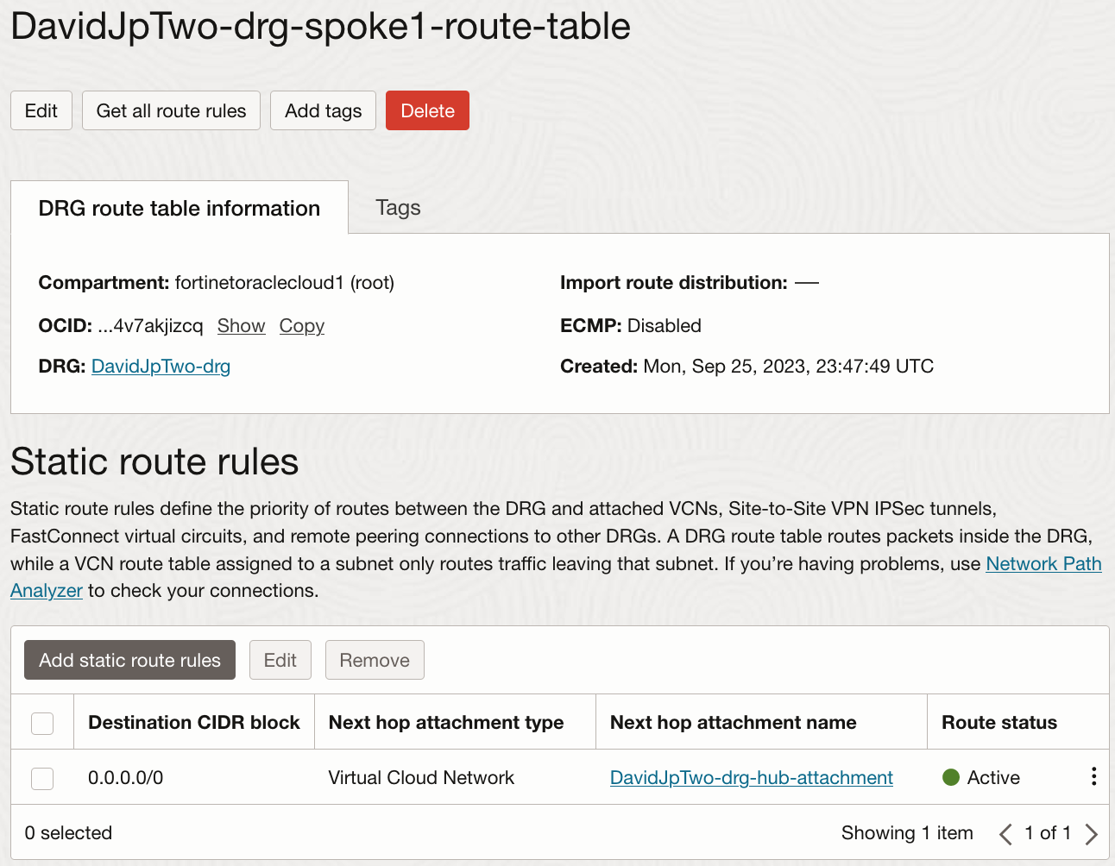
Configuration: DRG

Slide 26
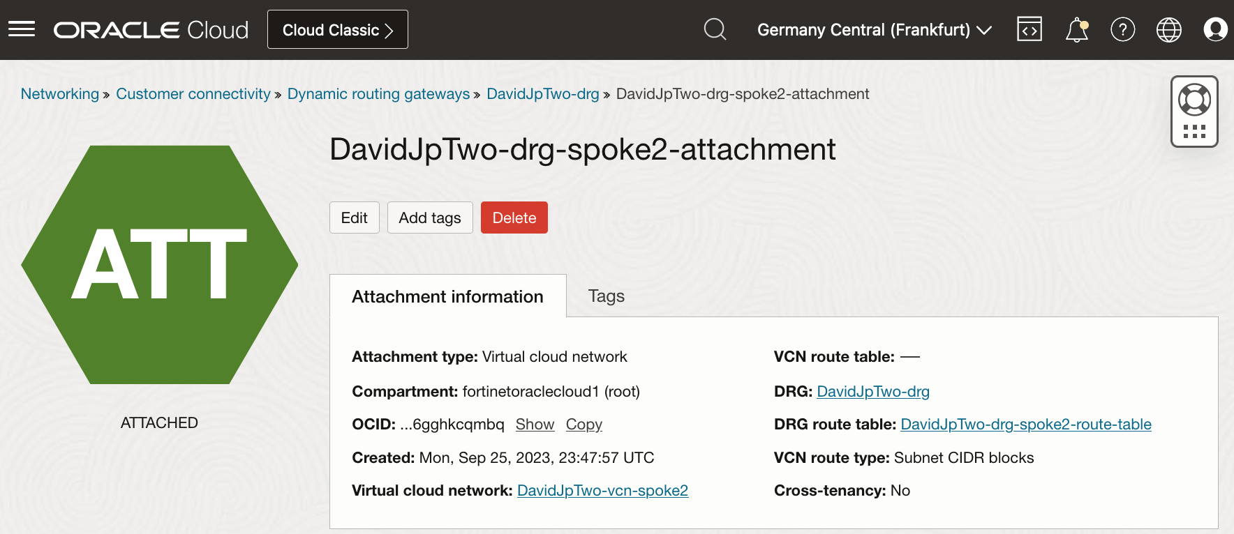

Configuration: DRG

Slide 27
Configuration: FortiGate-VM

Slide 28
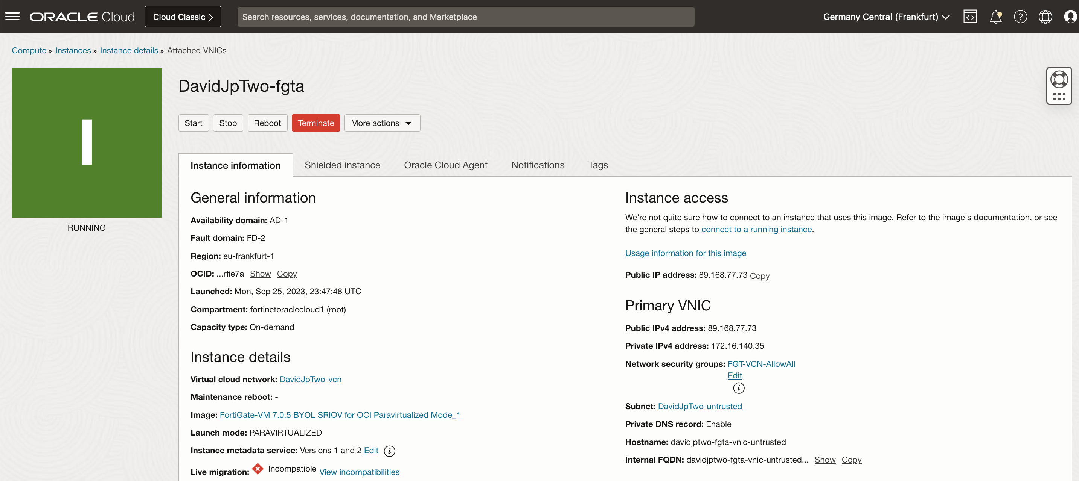
Configuration: FortiGate-VM

Slide 29
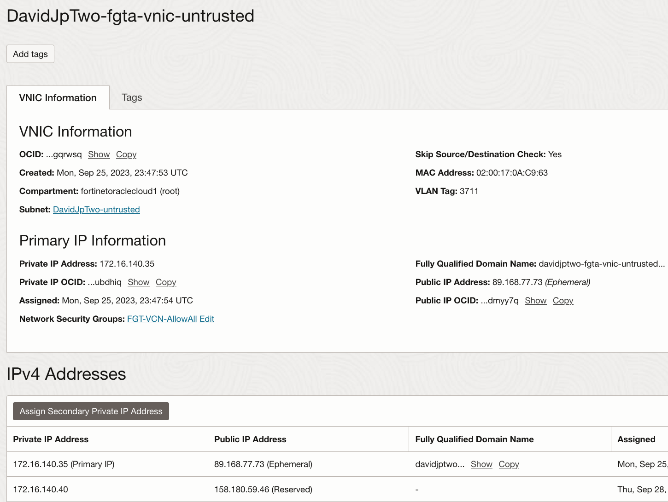
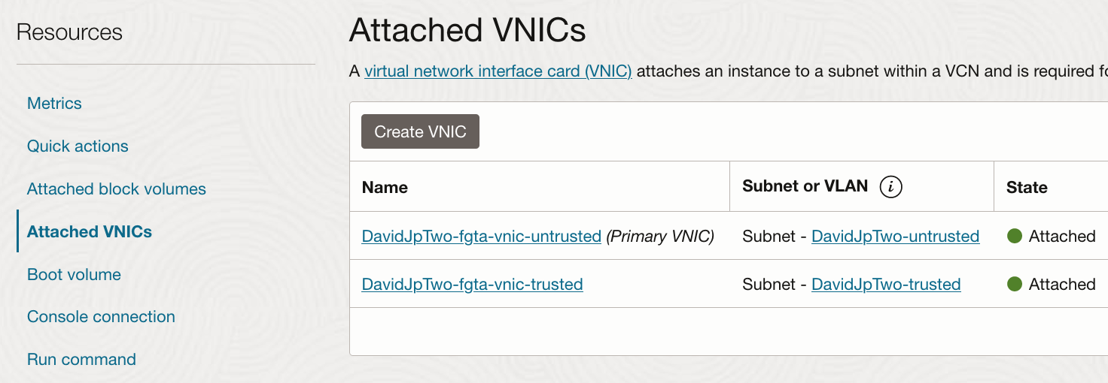
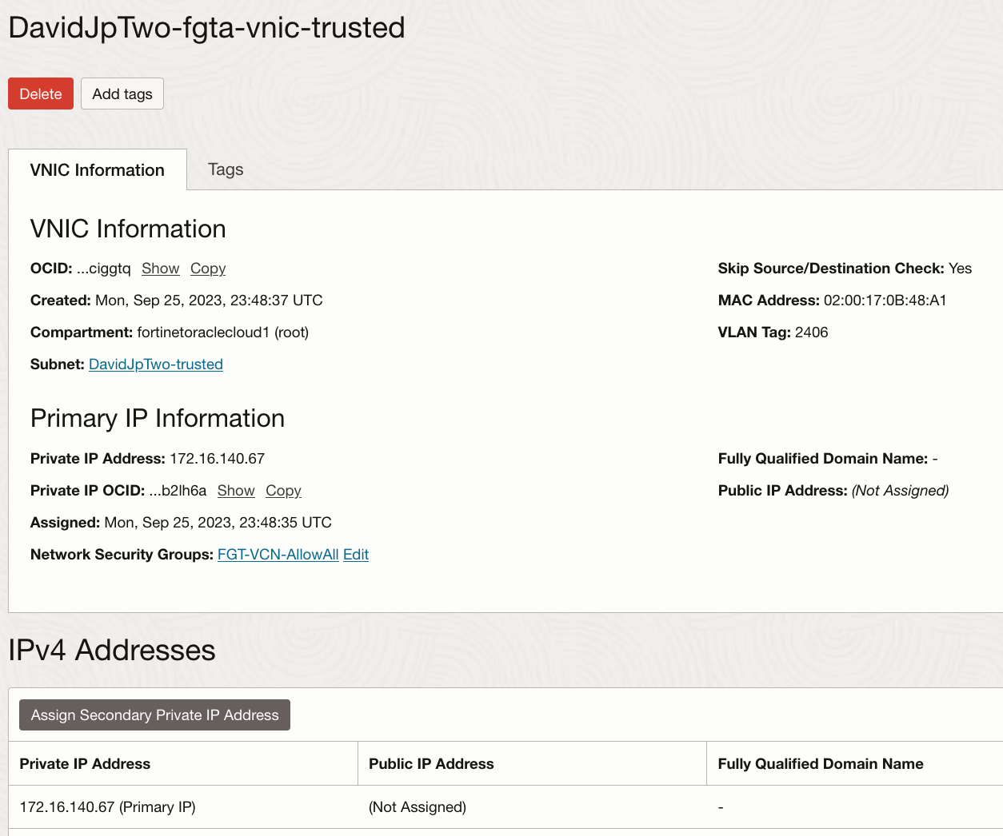
Configuration: FortiGate-VM

Slide 30
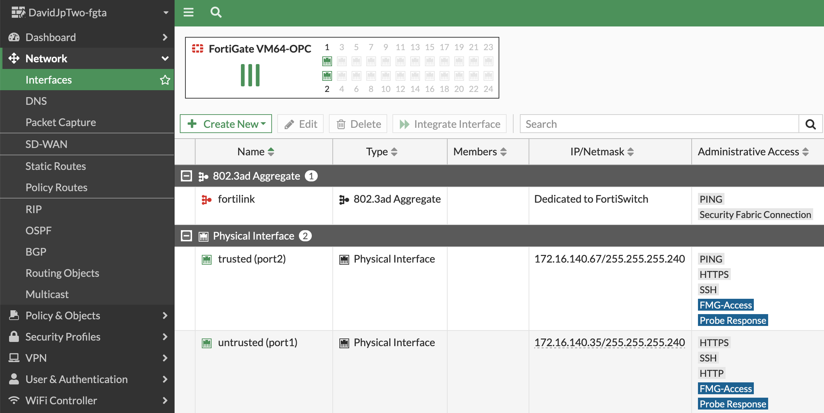
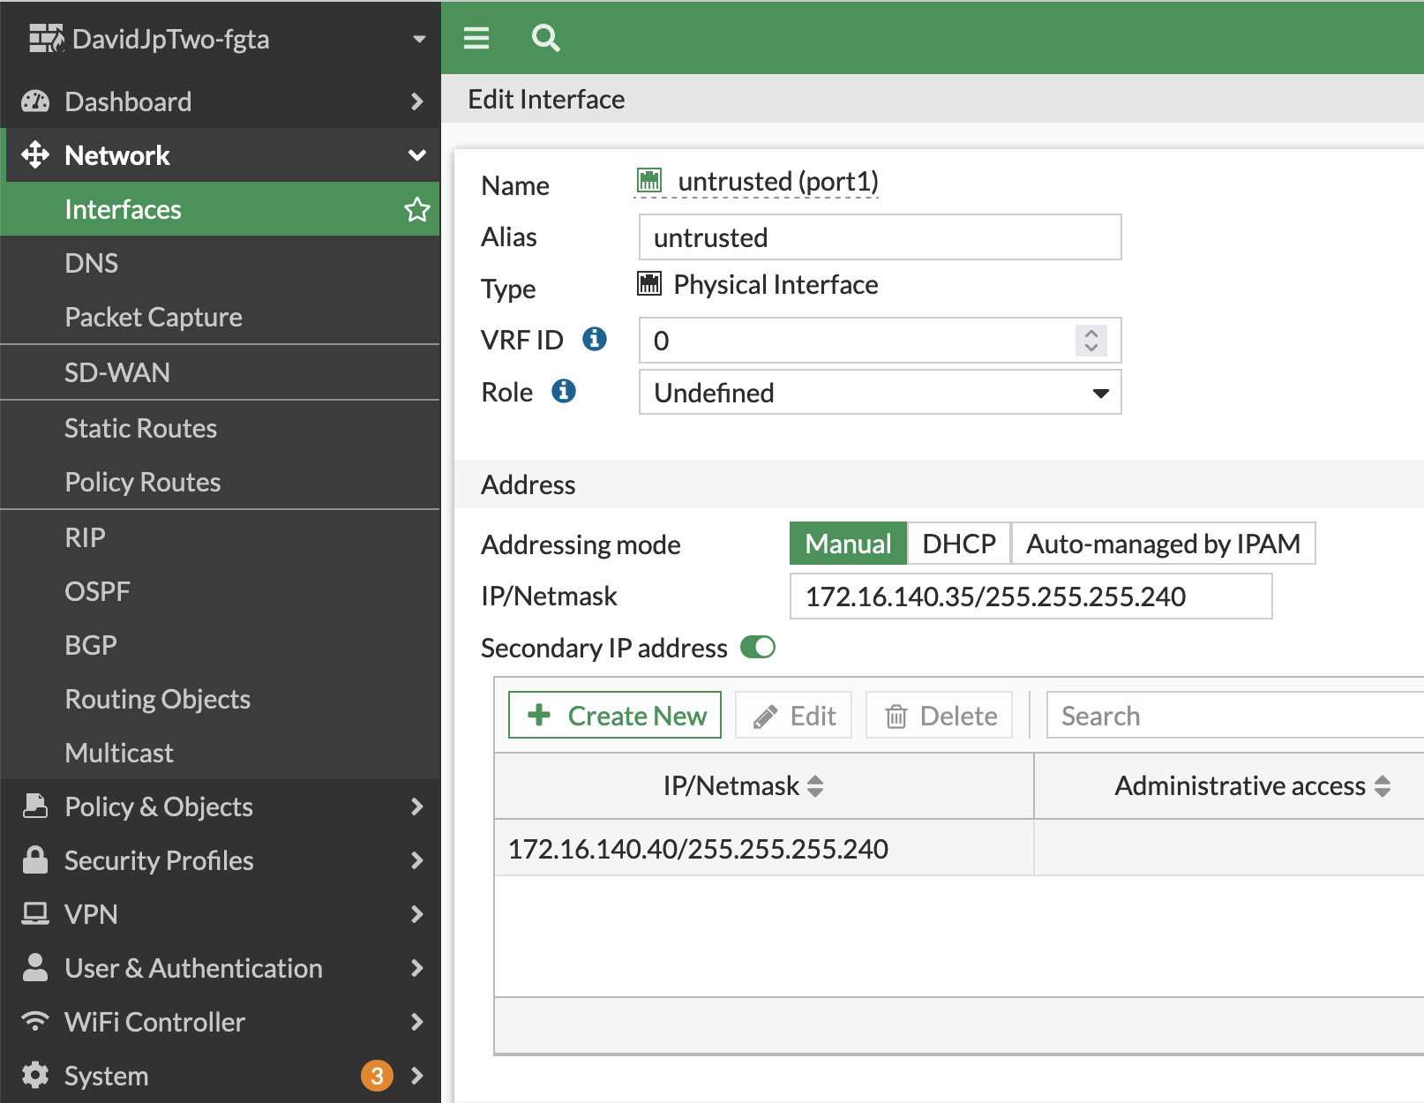
Configuration: FortiGate-VM

Slide 31
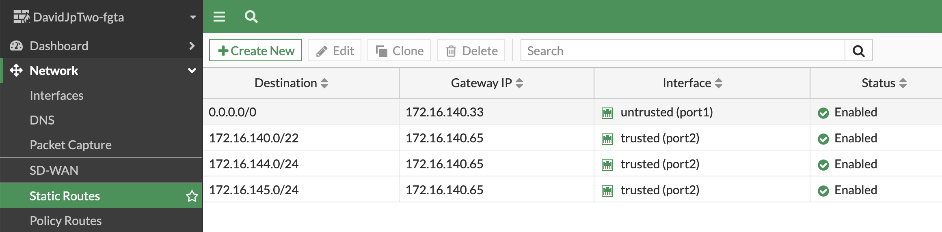
Configuration: FortiGate-VM

Slide 32
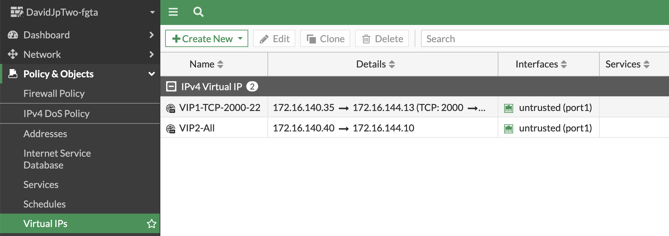
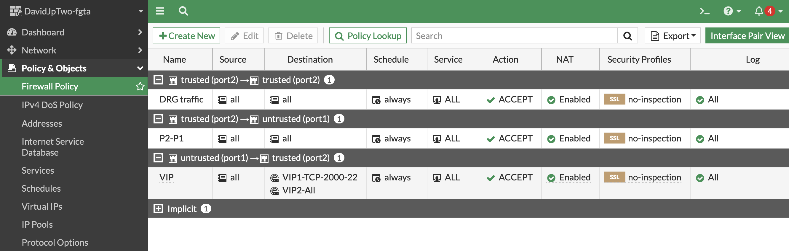
Configuration: FortiGate-VM

Slide 33
Configuration: Load Balancers

Slide 34
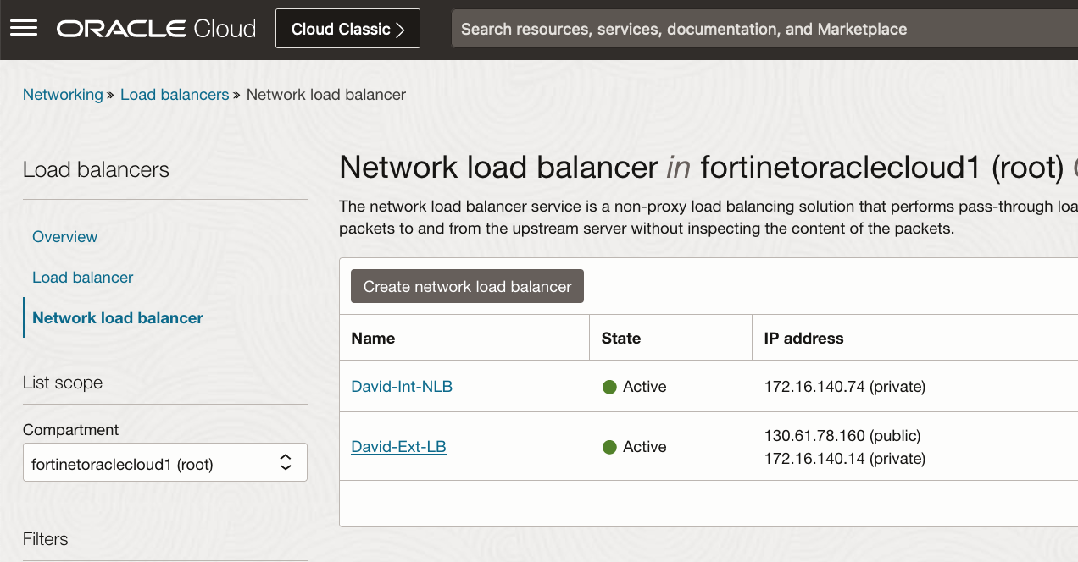
Configuration: Load Balancers

Slide 35
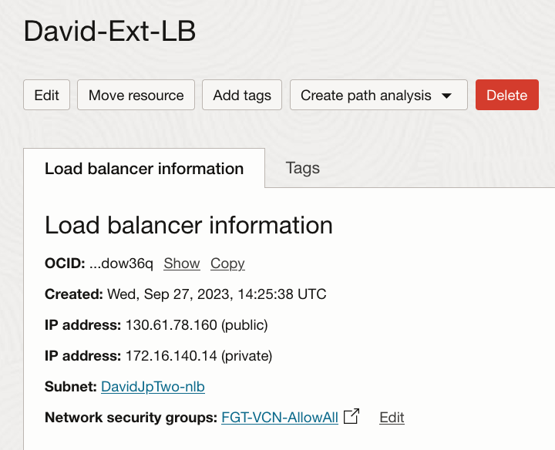
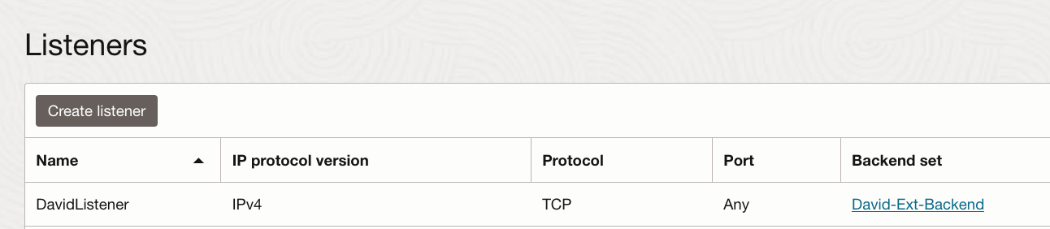
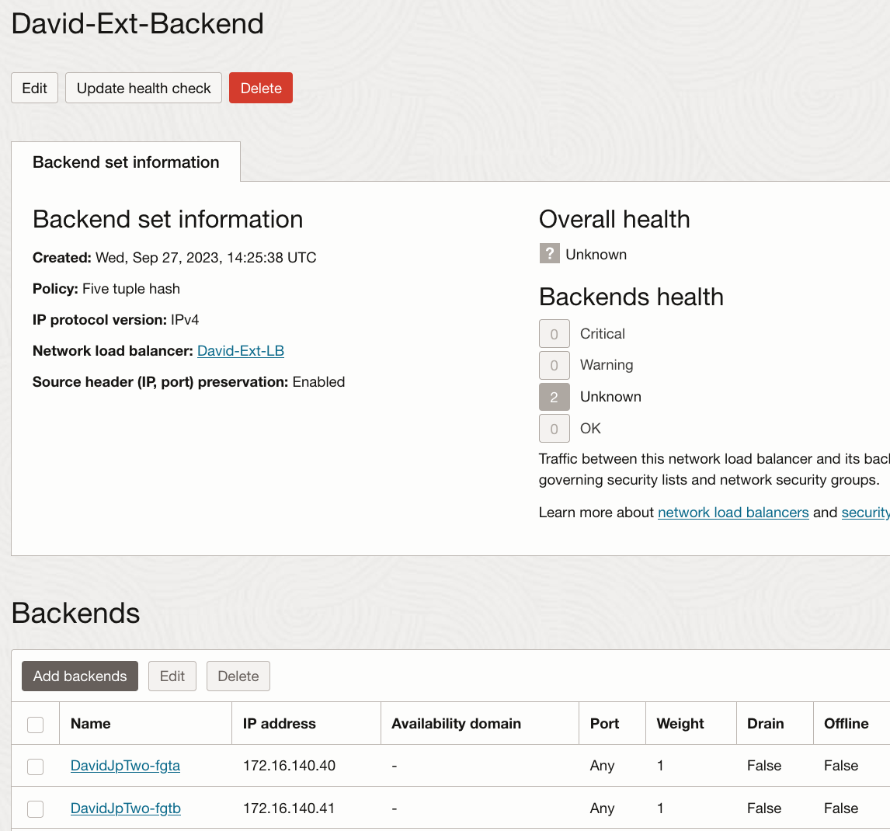
Configuration: Load Balancers

Slide 36
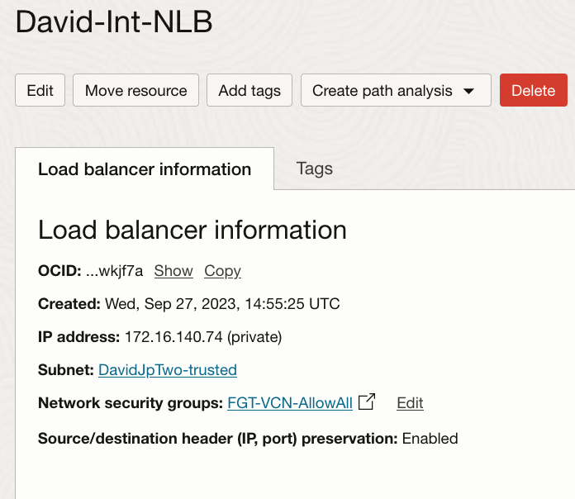
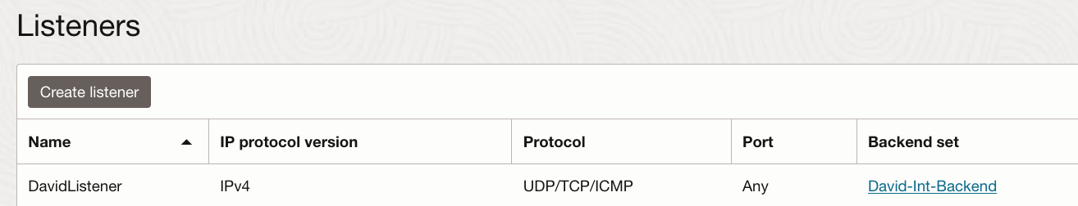
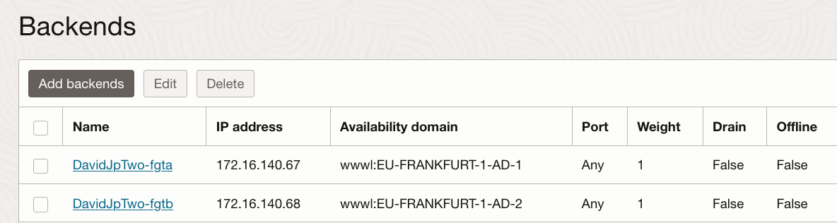
Configuration: Load Balancers

